Slide 1

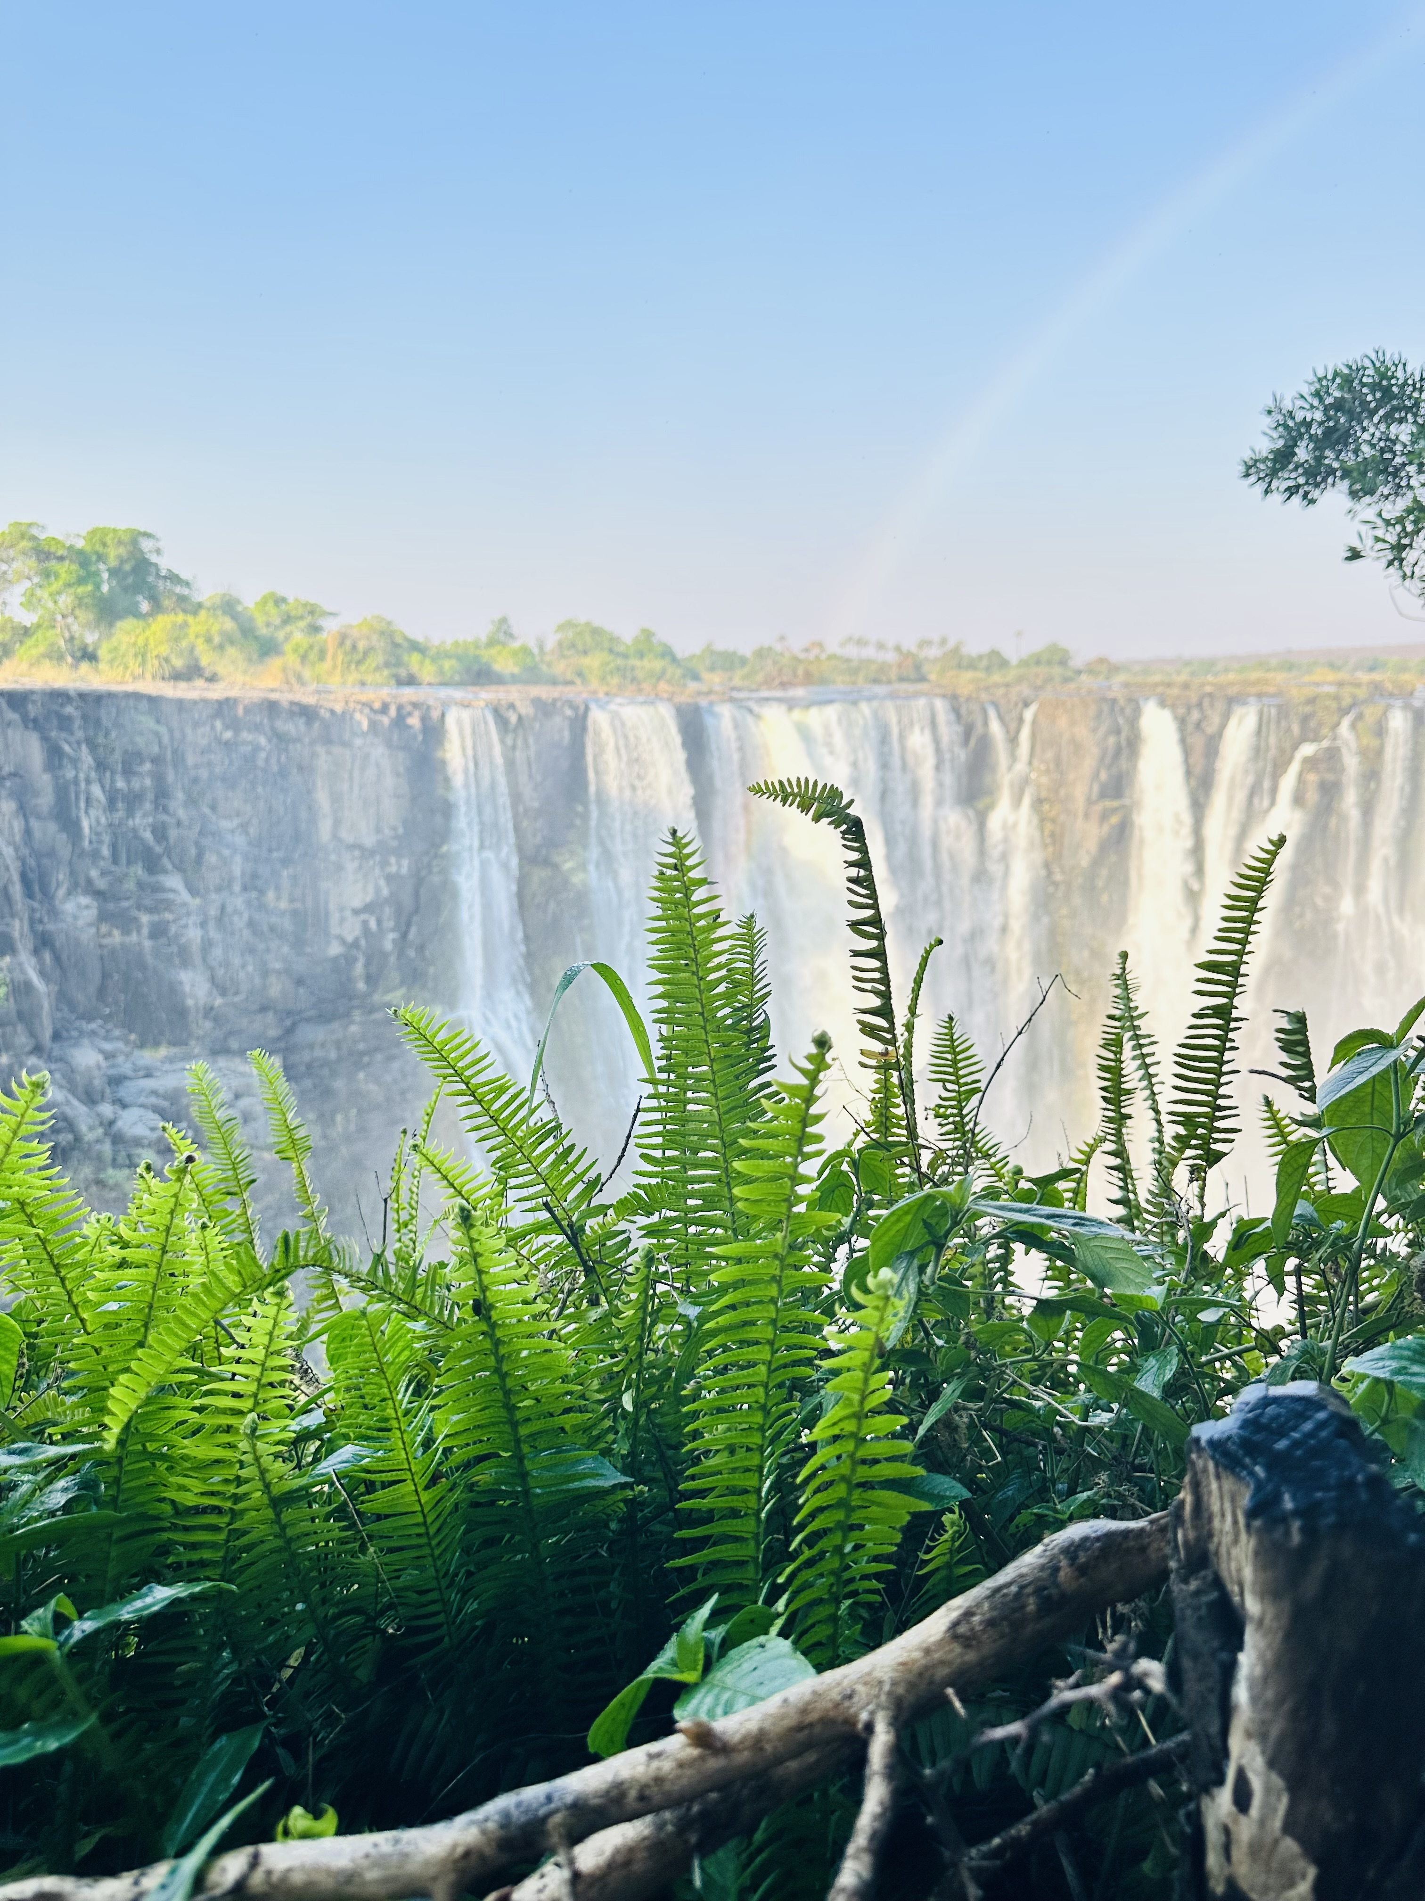

Here, the earth does not whisper.
It roars.
EXPERIENCES
DESTINATIONS
THE JOURNEY
ABOUT
PLAN YOUR TRIP
ADVENTURE · CURATED · AUTHENTIC
.
The river does not recognise borders. Neither do we.
PLAN YOUR TRIP

Slide 2
HOME · ABOUT
We did not discover this place.
We grew up in it.
Victoria Falls
Based & Operated
Dual-Licensed
Guides ZW & ZM
TWT curates private journeys through Zimbabwe, Zambia, and Botswana for travellers seeking more than sightseeing.
We were born in this landscape. We know its secrets by heart. We were raised by this landscape. We know where the river bends quietly at sunset, where the elephants cross at dusk, and when the bush asks for silence.
The Victoria Falls Triangle is one of the most concentrated collections of natural wonder anywhere on the planet. Within a few hours of each other sit a UNESCO World Heritage waterfall, one of Africa's greatest elephant sanctuaries, a river system teeming with the densest wildlife populations on the continent.
Entirely
Private Experiences
Seamless
cross-boarder travel
Design Your Journey →

Slide 3
HOME THE JOURNEY · HOW IT WORKS
How the journey unfolds
01
02
03
Discover
Curate
Arrive
Tell us what calls to you — the roar of the Falls, the silence of the bush, the rush of the rapids, the warmth of the fire.
We craft a private itinerary built entirely around you. Every detail considered. Every moment intentional.
Arrive in Victoria Falls and surrender to the journey. We take care of everything from here.
Start the Conversation →

Slide 4
HOME · THREE PILLARS
AFRICA, IN ALL IT’S CONTRASTS
WONDER
WILD
THRILL
Stand where the Zambezi tips over the edge of the world. Feel the mist before you see the water. Hear what Livingstone heard.
Hwange's elephant herds moving at dusk. Chobe's channels alive with hippo and buffalo. The Africa that exists before the rest of the world wakes up.
The gorge below the Falls is one of the most dramatic on earth. Fall into it, swing above it, fly over it, or ride its rapids.
Explore More →
Explore More →
Explore More →

Slide 5
HOME
The Journey
One river. Three nations. A journey without equal.
Explore More →

Slide 6
THE JOURNEY
2–4 DAYS
The Zambezi does not
recognise borders.
Short Escapes
The Falls, the gorge, a Zambezi sunset, a Chobe morning. An introduction that will demand a return.
It rises in the highlands of Zambia, swells through Zimbabwe, and pours itself into the channels of Botswana before continuing its ancient passage to the sea. It is one of the great rivers of the world, and the triangle it carves through southern Africa — the Victoria Falls Triangle — is where TWT All Africa One Journey was born.
A TWT journey follows this river. It follows its logic, its rhythms, and its stories. It takes you from the thunder of the Falls to the stillness of the Hwange plains to the abundance of the Chobe waterways. Three countries in one seamless, private, unhurried journey.
5–7 DAYS
Signature Journey
Victoria Falls. Livingstone Island. Chobe by boat. Hwange by game drive. The TWT journey in full.
8–12 DAYS
Extended Immersion
Go deeper. Walking safaris. Cultural visits. Village encounters. The stories told slowly and well.

Slide 7
HOME
Destinations
Victoria Falls · Livingstone · Chobe · Hwange
Explore More →

Slide 8
HOME DESTINATIONS · OVERVIEW
The Victoria Falls Triangle
VICTORIA FALLS
LIVINGSTONE
ZIMBABWE
ZAMBIA
The heartbeat of the journey. 1,708m wide. 108m tall. Mosi-oa-Tunya — the smoke that thunders. Where every TWT journey begins.
Cross the bridge. The Falls on the Zambian side — quieter, more intimate. Livingstone Island: one of the most singular experiences in Africa.
Explore More →
Explore More →
CHOBE
HWANGE
BOTSWANA
ZIMBABWE
One hour from Victoria Falls. One of the greatest concentrations of wildlife in Africa. Buffalo, elephant, hippo. The light at dusk turns everything amber.
14,000 sq km. Forty thousand elephants. Lion. Leopard. Wild dog. Vast, ancient, indifferent in the way only true wilderness can be.
Explore More →
Explore More →

Slide 10
DESTINATIONS · VICTORIA FALLS, ZIMBABWE
Victoria Falls,
Zimbabwe
1,708m
Width of the Falls
Every journey begins here.
The local name is Mosi-oa-Tunya. The smoke that thunders. When the Zambezi reaches the Falls at full flow, the spray rises three hundred metres and can be seen thirty kilometres away. The sound arrives before the sight. The mist soaks you before you reach the viewpoint.
David Livingstone called it the most wonderful sight he had witnessed in Africa. He was not exaggerating.
Victoria Falls is the heartbeat of this journey — wild, magnificent, and completely humbling. But it is more than the waterfall. It is the gorges carved over five million years. It is the rainforest that the spray sustains. It is the town built at the edge of wonder, where the energy is electric and the sunsets over the Zambezi are long and golden and quietly devastating.
This is where your journey begins. It rarely feels like enough.
108m
Height of the Falls
500M ℓ/min
Peak flow volume
UNESCO World Heritage Site

Slide 12
DESTINATIONS · LIVINGSTONE, ZAMBIA
Livingstone,
Zambia
◈
Livingstone Island
Accessible only by guided boat. Breakfast at the edge. Devil's Pool in season.
Cross the bridge. Enter another world.
The Victoria Falls Bridge connects Zimbabwe and Zambia across the second gorge — one of the most dramatic border crossings on earth. Below it, the river churns through the Batoka Gorge. Above it, bungee jumpers fall toward the water in a long, graceful arc.
On the Zambian side, the Falls reveal themselves differently. Quieter in some seasons. More intimate. And here, accessible only by guided boat across a channel of the Zambezi, sits Livingstone Island.
This is the island where the explorer stood in 1855 and looked out over what he called the most wonderful sight he had ever witnessed. Today, guests can sit at the very edge — the Devil's Pool in season, the table set for breakfast overlooking the cascade — and understand exactly what he felt.
It is one of the most singular experiences in Africa, and TWT facilitates access as part of your curated journey.
◆
The Bridge Crossing
One of the world's most dramatic border crossings. The gorge drops away below you.
✦
The Falls — Zambian Side
Quieter. More intimate. A different perspective on the same wonder.

Slide 13
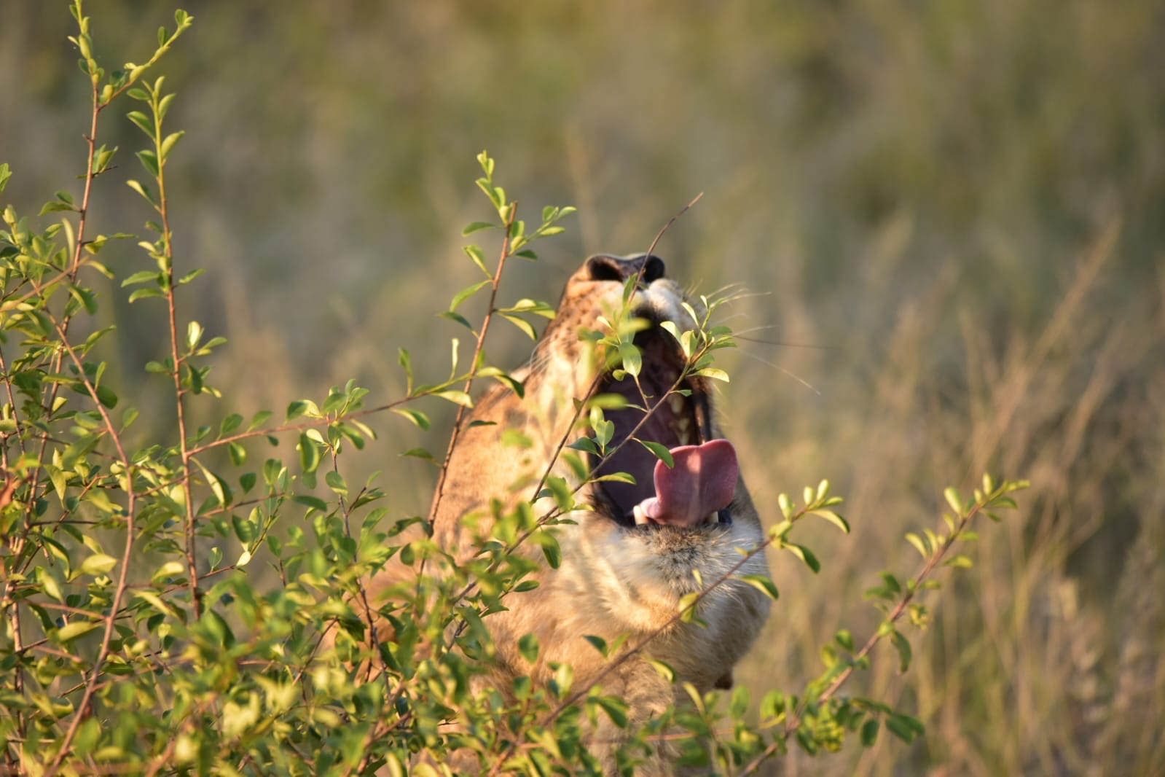

Slide 14
DESTINATIONS · CHOBE, BOTSWANA
Chobe,
Botswana
~120,000
Elephants in Chobe
Where the water holds more life than you can count.
An hour from Victoria Falls, the landscape shifts. The Chobe River moves slowly here, wide and generous, and along its banks gathers one of the greatest concentrations of wildlife in Africa. Buffalo herds that stretch to the horizon. Elephant families wading to drink, crossing, swimming — enormous and unhurried. Hippo eyeing the boat with mild irritation. Fish eagles calling from every other tree.
A Chobe boat safari is one of those experiences that recalibrates your sense of what wildlife abundance actually means. You drift. The animals come to you. The light in the late afternoon turns everything amber and still.
Botswana has built its entire tourism philosophy around low-volume, high-value conservation. You feel it here. There is space. There is quiet. There is the sense that the animals are not performing for you — they are simply living, and you have been allowed to witness it.
1 hr
Drive from Victoria Falls
HIGHLIGHTS
▸ Boat safaris on the Chobe River
▸ Buffalo & elephant in vast numbers
▸ Hippo, crocodile, fish eagle
▸ Amber light — golden hour photography
▸ Low-volume, high-value conservation

Slide 16
DESTINATIONS · HWANGE, ZIMBABWE
Hwange
National Park
14,651 km²
Park size
The old wilderness. Unchanged and uncompromising.
Hwange National Park is Zimbabwe's largest — fourteen thousand square kilometres of mopane woodland, teak forest, and open pans that hold water long after the rains have gone. It is around these pans that the wildlife congregates, and the concentrations here are among the most extraordinary in Africa.
Forty thousand elephants. Lion. Leopard. Wild dog — one of the most endangered predators on the continent, and one of Hwange's most celebrated residents. Sable antelope. Giraffe moving between trees in slow, improbable elegance.
Hwange is not manicured. It is vast and ancient and indifferent in the way only true wilderness can be. A game drive here at dawn, when the light is flat and pink and the animals are moving to the water, is the kind of experience that lodges itself permanently in memory.
This is the wild heart of the TWT journey.
40,000+
Elephants
KEY WILDLIFE
▸ African Wild Dog
▸ Lion & Leopard
▸ Sable Antelope
▸ Elephant
▸ Giraffe

Slide 17
HOME
Experiences
Choose your entry point into the extraordinary.

Slide 18
HOMR
EXPERIENCES · OVERVIEW
Four ways to enter
the extraordinary.
WONDER
WILD
THRILL
CULTURE
The Falls &
Livingstone Island
Hwange &
Chobe Safari
The Gorge
& Rapids
Fire, Story
& Belonging
A guided walk through the rainforest spray. A sunset on the Zambezi. Breakfast at the table set at the edge of the world.
Private, unhurried, guided by people who have spent their lives reading this landscape. Dawn drives. Boat safaris. Patience always rewarded.
Grade five white water. Bungee from the bridge. The gorge swing. The zipline. The microlight above it all.
An evening at the boma. Stories told the way they were always meant to be told — slowly, in the dark.
Explore →
Explore →
Explore →
Explore →

Slide 19
EXPERIENCES · WONDER
✦
The Falls &
Livingstone Island
Guided Rainforest Walk
Through the spray of the Falls, into the rainforest sustained by the mist.
There are places on this earth that exist beyond the reach of language. Victoria Falls is one of them.
One thousand seven hundred metres wide. One hundred and eight metres tall. Five hundred million litres of water per minute at peak flow. The statistics do not help. Nothing prepares you for the moment the sound finds you through the trees, and then the mist, and then suddenly the whole violent, gorgeous, overwhelming reality of it.
A guided walk through the rainforest spray. A sunset on the Zambezi upstream, where the water is still and the hippos surface slowly in the golden light. And for those who are ready — a boat across the channel to Livingstone Island. Breakfast at the table set at the edge of the world. The Devil's Pool, where the water pools impossibly at the lip of the cascade.
TWT facilitates Livingstone Island access as part of curated journeys. Seasonal availability applies.
◈
Livingstone Island
Boat access. Devil's Pool in season. Breakfast at the edge of the cascade.
◆
Zambezi Sunset Cruise
The water still. Hippos surfacing slowly. The light long and golden.

Slide 20
EXPERIENCES · WILD
◈
Hwange &
Chobe Safari
Game Drives
Dawn and dusk. Private vehicle. Your guide. The landscape on its own terms.
The bush does not reveal itself to those in a hurry.
A TWT safari is private, unhurried, and guided by people who have spent their lives reading this landscape. We know where the wild dogs denned last season. We know which pan the elephant matriarch prefers at midday. We know when to stop the vehicle and wait, and when the waiting becomes something worth remembering forever.
In Hwange, game drives at dawn and dusk when the light is extraordinary and the animals are moving. Walking safaris for those who want to feel the ground beneath their feet and understand the bush at human scale. At the pans, a patience that is always rewarded.
In Chobe, a boat on the river as the afternoon softens. The world's largest elephant population coming to drink. Buffalo. Hippo. Crocodile. Fish eagle. The kind of abundance that makes you feel you have arrived somewhere fundamental.
✦
Walking Safaris
Feel the ground. Read the tracks. Understand the bush at human scale.
◆
Boat Safaris — Chobe
Drift. The animals come to you. The afternoon light turns everything amber.

Slide 21
EXPERIENCES · THRILL
◆ White Water Rafting
The Gorge
& The Rapids
Grade 5. The Ghost. The Washing Machine. The guides are extraordinary.
▼ Bungee Jump
Below the Falls, the Zambezi enters the Batoka Gorge and becomes something else entirely.
This is grade five white water — some of the most technically demanding and exhilarating rafting on the planet. The rapids have names. The Ghost. The Washing Machine. Commercial Suicide. The guides are extraordinary. The experience is not for the faint-hearted and completely unforgettable for everyone else.
Above the gorge, the options multiply. Bungee from the bridge — 111 metres above the river, one of the original and most iconic bungee jumps in the world. The gorge swing, which trades the rebound for a long, breathless arc across the canyon. The zipline, which crosses the gorge at speed with the Falls visible in the distance. The microlight, which lifts you above all of it and gives you the view that belongs to eagles.
Some guests choose one. Some choose all. TWT builds your thrill itinerary around your appetite and your nerve.
111m above the river. One of the world's most iconic jumps.
◈ Gorge Swing & Zipline
A long, breathless arc. Speed across the canyon with the Falls ahead.
✦ Microlight Flight
Above the Falls. Above the gorge. The view that belongs to eagles.

Slide 22
EXPERIENCES · CULTURE
✦
Fire, Story
& Belonging
Community Visits
The rhythms of daily life. Honest. Welcoming. A genuine encounter.
The landscape is only half the story.
The people who have lived alongside the Zambezi for thousands of years carry the other half — in their languages, their ceremonies, their relationship with the land, and the way they tell a story around a fire after dark.
A TWT cultural experience is not a performance. It is an encounter. A visit to a local community, where the rhythms of daily life are visible and honest and genuinely welcoming. An evening at the boma — the traditional enclosure — where food is cooked over open fire and the conversation moves between languages and generations.
Voices Around the Fire, our signature evening experience, where the stories of this landscape are told the way they were always meant to be told — slowly, in the dark, with the bush listening.
This is the part of the journey that guests mention last and remember longest.
◈
Evening at the Boma
Food over open fire. Conversation across languages and generations.
◆
Voices Around the Fire
Our signature evening. Stories told slowly, in the dark, with the bush listening.

Slide 23
HOME
About TWT
We did not find this place on a map. We grew up inside it.

Slide 24
ABOUT TWT · OUR STORY
We live here.
Born in the bundu.
Our knowledge is not researched — it is lived.
TWT All Africa One Journey was not built in a boardroom. It grew from a lifetime of mornings in the Hwange woodland before the heat arrived, of afternoons on the Zambezi watching the light change, of evenings around fires where the stories were older than anyone present.
It grew from a love of this ecosystem — its logic, its beauty, its fragility, its extraordinary generosity — and from a belief that the people who travel here deserve to experience it the way we do. Not from a distance. From inside it.
We are Victoria Falls guides, licensed across Zimbabwe and Zambia, operating across the triangle that the Zambezi River draws through three nations. We know this place the way you know a home.
When you travel with TWT, you are not buying a product. You are being introduced to somewhere we love, by people who have spent their lives earning the right to show it properly.
We go private.
No shared vehicles. No group itineraries. No compromises.
We are licensed.
Dual-licensed across Zimbabwe & Zambia. KAZA UniVisa zone.
We know the stories.
Ecological, historical, deeply human. The stories that make a place unforgettable.

Slide 25
"
HOME
We did not discover this place.
We grew up in it.
The bundu raised us. The Zambezi taught us patience. The bush taught us to listen before we speak.
TWT All Africa One Journey exists because we believe the stories of this landscape deserve to be heard — and that the people who travel here deserve to hear them properly, from someone who has lived them.
This is not a tour. It is an introduction to a place we love.
Our work is not simply to guide you through this region. It is to translate it
— The TWT Team, Victoria Falls

Slide 26
HOME
Explore the triangle
Tell us about the journey you are imagining. We will make it real.

Slide 27
HOME PLAN YOUR JOURNEY · ENQUIRY
Every TWT journey begins
with a conversation.
ENQUIRY FORM (HIDDEN)
NAME
TRAVEL DATES
There are no fixed packages, no off-the-shelf itineraries, no one-size-fits-all solutions. There is only your time, your vision, and our knowledge of this landscape — combined into something built entirely for you.
Whether you have two days or twelve, whether you are travelling alone or with a group, whether you come for the wildlife or the adrenaline or the culture or simply because the Falls have been calling you for years — we will design something worthy of the journey.
GROUP SIZE
JOURNEY LENGTH
ENQUIRY FORM
WHAT CALLS TO YOU MOST
Fill in the form and a member of the TWT team will be in touch within 24 hours.

Slide 28
HOME PLAN YOUR JOURNEY · TRADE & AGENTS
Your eyes. Your ears.
Your trusted hands on the ground.
✦
Deep Destination
Knowledge
TWT All Africa One Journey works with a select network of international travel agents, tour operators, and DMCs to deliver premium ground experiences across the Victoria Falls Triangle.
We are your on-the-ground partner. We handle logistics, guiding, supplier relationships, and the thousand small details that make the difference between a good trip and an unforgettable one. Our destination knowledge is deep, our supplier relationships are personal, and our commitment to your clients' experience is absolute.
We welcome trade enquiries and are happy to discuss preferred partner arrangements, rates, and familiarisation visits.
◈
Personal Supplier
Relationships
◆
Absolute Commitment
to Your Clients
Trade Enquiry → agent@twtallafricaonejourney.com

Slide 29
We design private journeys for travellers seeking depth, stillness, and access
Private departures only.”
“Best experienced between May and October.”
“Designed around the rhythm of the river.”
“No fixed itineraries.”
“Curated from Victoria Falls.

Slide 30
HOMEBEGIN YOUR JOURNEY
The smoke that thunders.
We will take you there.
LOCATION
Victoria Falls, Zimbabwe ·
EMAIL
inquiries@twtallafrica.com
WHATSAPP
+263 776 069 701
WEB
southseventeenevents.com
Victoria Falls based & operated · Private journeys · 2–12 days · KAZA UniVisa zone

